Slide 1
The 8051 Microcontroller and Embedded Systems
CHAPTER 1
THE 8051 MICROCONTROLLERS
vignan university

Slide 2
OBJECTIVES
Compare and contrast microprocessors and microcontrollers
Describe the advantages of microcontrollers for some applications
Explain the concept of embedded systems
Discuss criteria for choosing a microcontroller
Explain the variations of speed, packaging, memory, and cost per unit and how these affect choosing a microcontroller
Compare and contrast the various members of the 8051 family
Compare 8051 microcontrollers offered by various manufacturers
vignan university

Slide 3
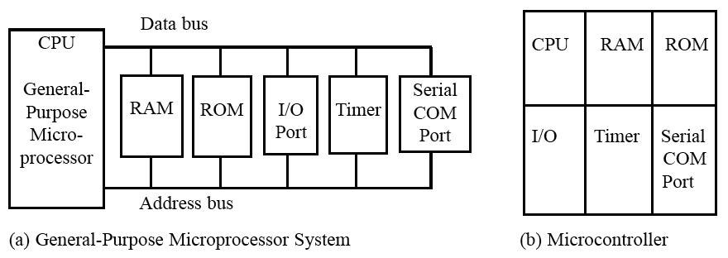
SECTION 1.1: MICROCONTROLLERS AND EMBEDDED PROCESSORS
Microcontroller versus general-purpose microprocessor
vignan university
Figure 1–1 Microprocessor System Contrasted With Microcontroller System

Slide 4
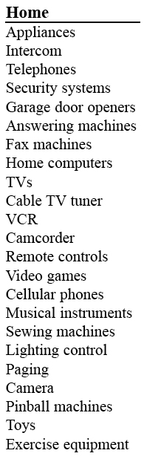
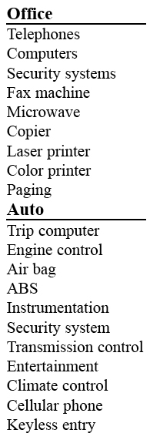
SECTION 1.1: MICROCONTROLLERS AND EMBEDDED PROCESSORS
Microcontrollers for embedded systems
Table 1–1
Some Embedded Products
Using Microcontrollers
vignan university

Slide 5
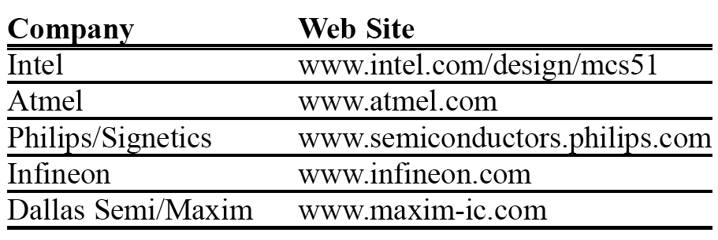
SECTION 1.1: MICROCONTROLLERS AND EMBEDDED PROCESSORS
Choosing a microcontroller
vignan university

Slide 6
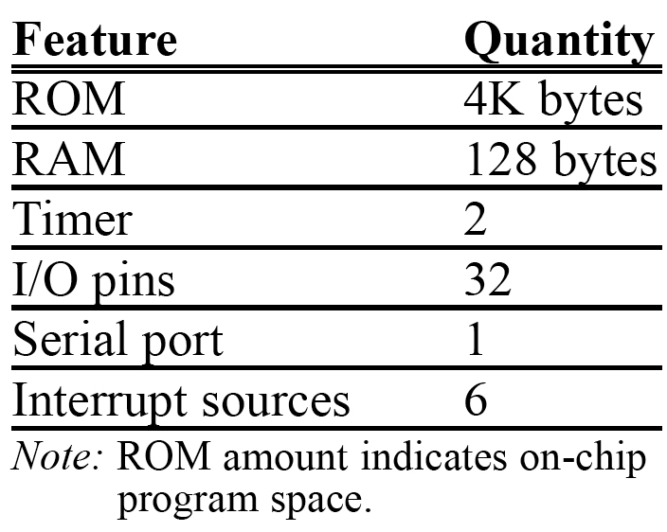
SECTION 1.1: MICROCONTROLLERS AND EMBEDDED PROCESSORS
Criteria for choosing a microcontroller
Table 1–3 Features of the 8051
vignan university

Slide 7
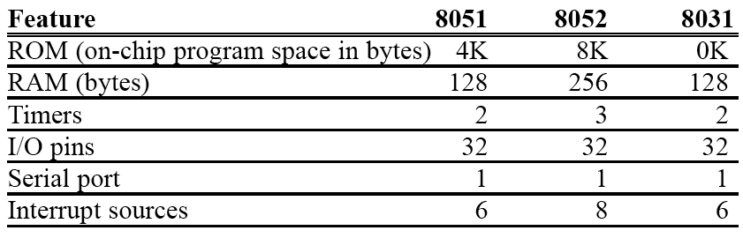
SECTION 1.1: MICROCONTROLLERS AND EMBEDDED PROCESSORS
Table 1–4 Comparison of 8051 Family Members
vignan university

Slide 8
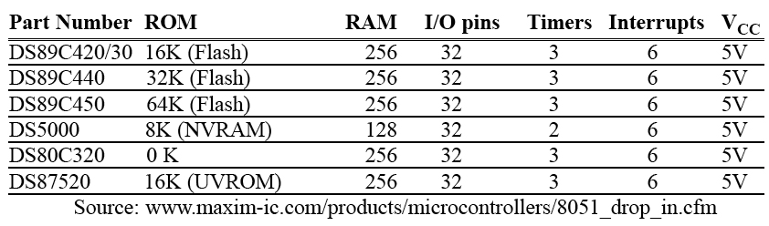
SECTION 1.1: MICROCONTROLLERS AND EMBEDDED PROCESSORS
Table 1–5
Versions of 8051/52 Microcontroller From Dallas Semiconductor (Maxim)
vignan university

Slide 9
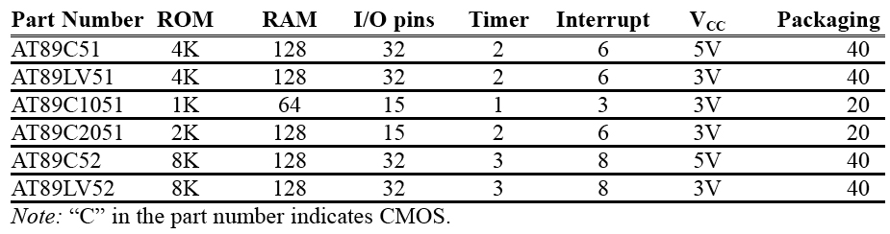
SECTION 1.1: MICROCONTROLLERS AND EMBEDDED PROCESSORS
Table 1–6 Versions of 8051 From Atmel (All ROM Flash)
vignan university

Slide 10
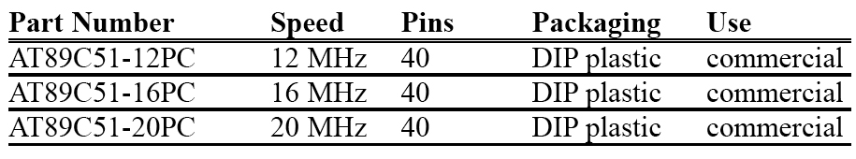
SECTION 1.1: MICROCONTROLLERS AND EMBEDDED PROCESSORS
Table 1–7 Various Speeds of 8051 From Atmel
vignan university

Slide 11
A brief history of the 8051
In 1981, Intel Corporation introduced an 8-bit microcontroller called the 8051.
This microcontroller had 128 bytes of RAM, 4K bytes of on-chip ROM, two timers, one serial port, and four ports (each 8-bits wide) all on a single chip.
The 8051 is an 8-bit processor, meaning that the CPU can work on only 8 bits of data at a time.
Data larger than 8 bits has to be broken into 8-bit pieces to be processed by the CPU.
vignan university

Slide 12
A brief history of the 8051
The 8051 has a total of four I/O ports, each 8 bits wide.
Although the 8051 can have a maximum of 64K bytes of on-chip ROM, many manufacturers have put only 4K bytes on the chip.
The 8051 became widely popular after Intel allowed other manufacturers to make and market any flavors of the 8051 they please with the condition that they remain code-compatible with the 8051.
This has led to many versions of the 8051 with different speeds and amounts of on-chip ROM marketed by more than half a dozen manufacturers.
vignan university

Slide 13
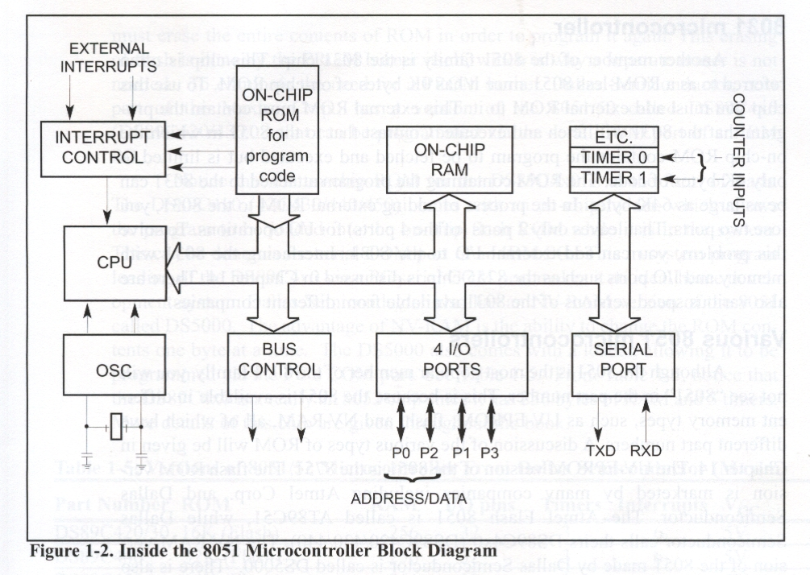
SECTION 1.2: OVERVIEW OF THE 8051 FAMILY
vignan university

Slide 14
8052 microcontroller
The 8052 is another member of the 8051 family.
The 8052 has all the standard features of the 8051 as well as an extra 128 bytes of RAM and an extra timer.
8052 has 256 bytes of RAM and 3 timers.
It has 8K bytes of on-chip program ROM instead of 4K bytes.
vignan university

Slide 15
8031 microcontroller
This chip is often referred to as a ROM-less 8051 since it has 0K bytes of on-chip ROM.
To use this chip you must add external ROM to it.
This external ROM must contain the program that the 8031 will fetch and execute.
The ROM containing the program attached to the 8031 can be as large as 64K bytes.
In the process of adding external ROM to the 8031, you lose two ports.
To solve this problem, you can add external I/O to the 8031. Interfacing the 8031 with memory and I/O ports such as the 8255 chip is discussed in Chapter 15.
vignan university

Slide 16
Various 8051 microcontrollers
The 8051 is available in different memory types, such as UV-EPROM, flash, and NV-RAM, all of'which have different part numbers.
The UV-EPROM version of the 8051 is the 8751.
The flash ROM version is marketed by many companies including Atmel Corp. and Dallas Semiconductor.
The Atmel Flash 8051 is called AT89C51, while Dallas Semiconductor calls theirs DS89C4xO (DS89C420/430/440).
The NV-RAM version of the 8051 made by Dallas Semiconductor is called DS5000.
There is also an OTP (one-time programmable) version of the 8051 made by various manufacturers.
vignan university

Slide 17
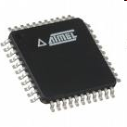

AT89S8253 from Atmel Corporation
We will be using this version of the 8051 in the lab. Each student will be given a chip to program.
Look at the specs of this version at http://www.atmel.com/dyn/resources/prod_documents/doc3286.pdf
vignan university

Slide 18
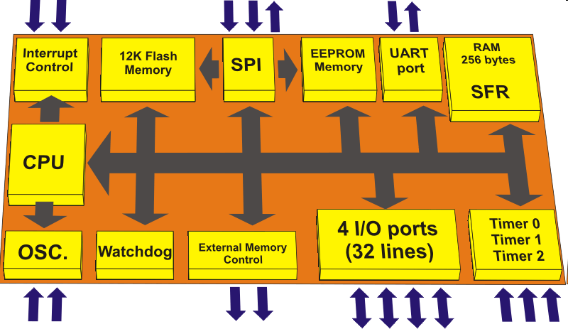
AT89S8253 from Atmel Corporation
http://www.mikroe.com/en/books/8051book/ch4/
vignan university

Slide 19
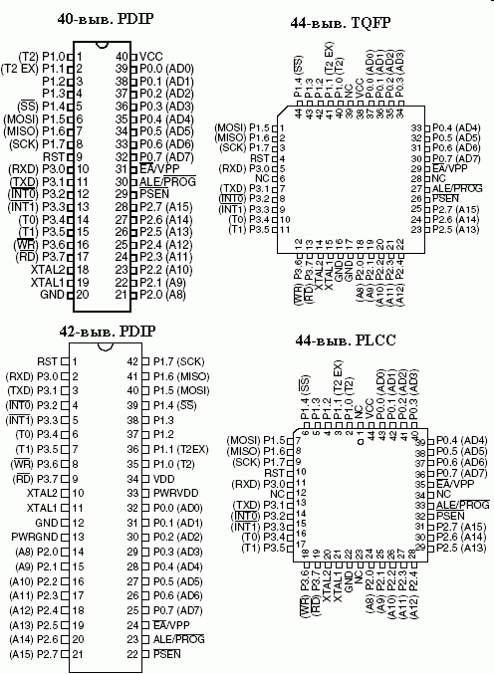
AT89S8253 from Atmel Corporation
vignan university
http://www.gaw.ru/im/atmel/at89/AT89S8253_pic2.gif

Slide 20
Next …
Lecture Problems Textbook Chapter 1
  Answer as many questions as you can and submit via MeL before the end of the lecture.
Proteus Exercise Textbook Chapter 1
  Do as much of the Proteus exercise as you can and submit via MeL before the end of the lecture.
vignan university

